Slide 1
BASIC OOAD Process

Slide 2
BASIC OO Concept
The Object Oriented three basic concepts are
    Reuse
    Object Oriented Analysis/ Object Oriented Design
    The General OOAD Process

Slide 3
One of the major benefits of OO technology, as claimed by its promoter,
  is that enables to reuse.
The most common kind of reuse is through libraries.
The user of the library is presented a description of interface.
One is supposed to be able to use the API (application programmers interface) without a deep understanding of the implementation details of the library.

Slide 4
Another form of reuse concerns low level architectural details, that is at the level of algorithms and data structures.
All of us are familiar with the generic description of an algorithm,
    like quick sort (fast sorting algorithm-suitable for sorting big data volumes),
    which we then code in language chosen for the application.
We all know about binary trees (made of nodes, which contains a left pointer , a right pointer), and we do not have to re-invent them for every application.
Design patterns are also an example of this level of reuse.

Slide 5
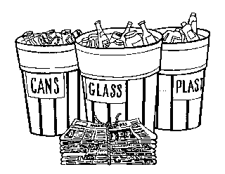
1. Reuse
Reuse is the recovery of materials and products for the same or a similar end use.
It involves taking useful products, such as furniture, books and appliances, discarded by those who no longer want or need them and redistributing them to those who do.
In contrast to recycling, which recovers materials for processing, reuse recovers the original product.

Slide 6
2. Object-Oriented Analysis / Object- Oriented Design
Object-Oriented = Objects + Communication + Classification + Inheritance
The key idea of OO design is:
  System requirements are represented in terms of interacting objects.

Slide 7
3. The general OOAD process
The general analysis and design process involves identifying (not in any order) the following things:
  Objects and Classes
  Responsibilities: data and function.
  Collaborators: what other classes helps to carry out the responsibilities.
  Inheritance: similarity among classes.
  Subsystems: collections of objects and classes that perform a task.

Slide 8
Typically these components are common to all OO Analysis methods:
  Information Modeling: Identify the entities and relationships in the problem. That is, what are the
    objects
    attributes of the objects
    relationships among the objects
  Lifecycle Modeling: Identify the way that an object responds to its environment. That is, what are the
    position that the object can be in.
    events that cause transitions (switch/move) between states (Positions of Objects)
    the actions association.

Slide 9
BASIC OOAD Process:
Basic OOAD process is the foundational process.
So, we start there with this questions:
  “What is good to creating a system using sound Object Oriented Analysis and Design principles?”
  “What is lightweight to creating a system using sound Object Oriented Analysis and Design principles?”
  “What is flexible to creating a system using sound Object Oriented Analysis and Design principles?”,
  “What is basic approach to creating a system using sound Object Oriented Analysis and Design principles?”

Slide 10
The Four Ps:
In the Software Development work, used four important Ps (4Ps).
It is used for the development of software efficiently.
The four Ps are:
  People
  Project
  Product
  Process/Tools

Slide 11
People (Feasibility Study, Risk Management, Team Structure, Project Schedule, Project Understandability, Project Accomplishment)
  The architecture, developers, testers, and their supporting management, plus users, customers, and other stakeholders are the prime movers in a software project.
  People are actual human beings, as opposed to the abstract construct.
Project ( Project works)
  The organizational element through which software development is managed. The outcome of a project is a released product.
  Product (Result of Project)
  Artifacts that are created during the life of the project, such as models, source code, executables, and documentation.

Slide 12
Process
  A software engineering process is a definition of the complete set of activities needed to transform users’ requirements into a product.
  So, A process is a template for creating projects.
Tools
  Software that is used to automate the activities defined in the process.
Process
Template
Automation
People
Project
Tools
Participants
Result
Product

Slide 13
Core Steps of OOAD Process:
Engineers solve complex problems.
In the core steps the most powerful is a standard, structured approach to solving any problem.
Here are four core steps, which is used for problem solving in OOAD process.
The core steps are:
    Concept – problem identification
    Analysis – problem understanding
    Design – create solution plan
    Implementation – create physical solution

Slide 14
Problem Solving – Core Steps
Step | Objectives | Deliverable
Concept (Problem Identification) | 1. Capture the essence of what to solve? (real meaning) | 1. One or more sentences describing the vision to achieves and key objectives.
Analysis (Problem Understanding) | 1. Define the problem in details sufficient to provide a satisfactory solution | 1. A breakdown of the problem into clearly understand detail.
Design (Create Solution Plan) | 1. Clearly visualized a satisfactory solution in terms of intentions. | 1. A model showing solution components with their relationships and responsibilities.
Implementation (Create Physical Solution) | 1. Translate the design into working product. | 1. Working solution, such as source code, executables, images, documentation.

Slide 15
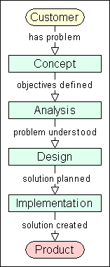
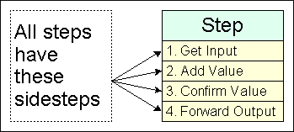
All the steps have these sidesteps.
The key sidestep is Confirm Value.
Our goal is to make all steps as uniform but as flexible as possible.
This can be done by adding a rather interesting abstraction, sidesteps.
It allows eliminating the common separate testing steps, integrating value with quality throughout the process.

Slide 16
Example of confirm value are requirement review, mapping of design to requirement elements, code inspection (checking) and testing.
By the help of sidesteps input and output can standardized per step.
Standard input includes People, Skills, Previous Step, Standards and cumulative product and artifacts,
Standard output includes the Product, Artifacts, metrics, Spot improvements and better skills.

Slide 17
The Cycle Plan Step:
The Cycle Plan Step is most important step in OOAD Process.
The following diagram shows the flow from Customer to end Product.
Here in this diagram includes four minimum steps.
These are performed in sequence to gradually move from customer needs to final product.

Slide 18
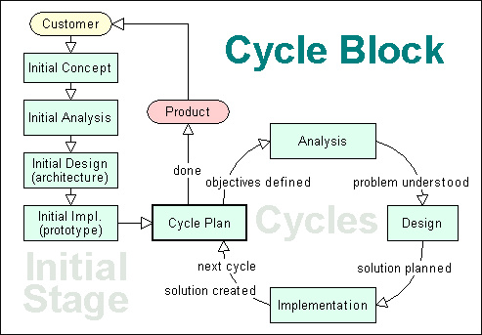
Flowchart of Five Step Types Cycle Block

Slide 19
This is the classic waterfall process, where one continues in a straight lines as if falling from the start to the finish.
The problem with the waterfall approach is each step has to be 100% complete before going to the next step, and each step has to remain stable until all are finished.
So, to define a standard cyclic process we need one more step type, which is Cycle Plan for OOAD Process.
It allows process flow to repeat planned cycles again and again until the Cycle Plan is done.

Slide 20
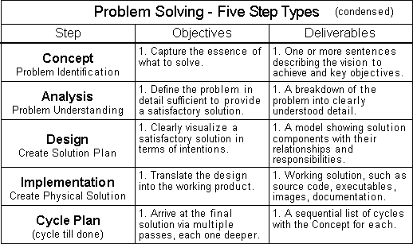
Five Step Types Cycle Plan:
Adding Cycle Plan gives the fifth and final step type.
The key feature of the Cycle Plan step is it produces a list of Concepts organized along a timeline.

Slide 21
Sub steps of Step:
We need to expand a step into a procedure. And done with sub steps.
For example the design step may have the sub steps.
Step: All works is done in defined steps
Substep: A step is composed of sequential or unordered substeps.
Sidestep: A step is also composed of sequential sidesteps and have substeps and sidesteps.
Design
Steps can have
sub steps
1. Acceptance Design
2. Functional Design
3. Implementation Cycle Plan

Slide 22
Four Standard Sidesteps:
  Get Input
  Add Value
  Confirm Value
  Forward Output

